Slide 1

Bangladesh Army University of Science and Technology(BAUST)
Project Topic
Crime Analysis for Bangladesh
Presented By
Md. Imran Parvez (200101024)
Md. Rasa Raj (200101054)
Presented To
Md. Mamun Hossain
(Assistant Professor, BAUST)
Jerin Tasnim
(Lecturer,BAUST)

Slide 2

Contents
Introduction
Objective
Background on Crime in Bangladesh
Data Clustering & Applying Models
Result and Analysis
Conclusions
Data Collection & Description

Slide 3
Introduction
Crime analysis involves the systematic study of crime data to identify patterns, trends, and valuable insights that aid law enforcement agencies and policymakers in combating crime effectively.
By leveraging data-driven approaches, we can proactively prevent and address criminal activities, making our neighbourhoods safer for everyone. In this presentation, we will explore the objectives, methods, and benefits of crime analysis, highlighting how this vital process plays a pivotal role in maintaining public safety.
Let's dive in and discover the power of data-driven crime analysis.

Slide 4
Objective
I understand from this dataset that from here it is found in its objective-
Crime Prevention
Investigation Support
Resource Allocation
Policy Development
Evaluating Interventions
Crime Trend Prediction
Data-Driven Decision Making

Slide 5
Background on Crime in Bangladesh
Bangladesh has experienced a range of criminal activities over the years, including traditional crimes like theft, burglary, and robbery, as well as more complex and evolving crimes.
Crime rates in Bangladesh have shown fluctuations over the years. Factors such as economic conditions, social unrest, and political instability have influenced these trends.
The COVID-19 pandemic had an impact on the crime landscape, with changes in patterns and an increase in certain types of cybercrimes as more activities moved online.

Slide 6
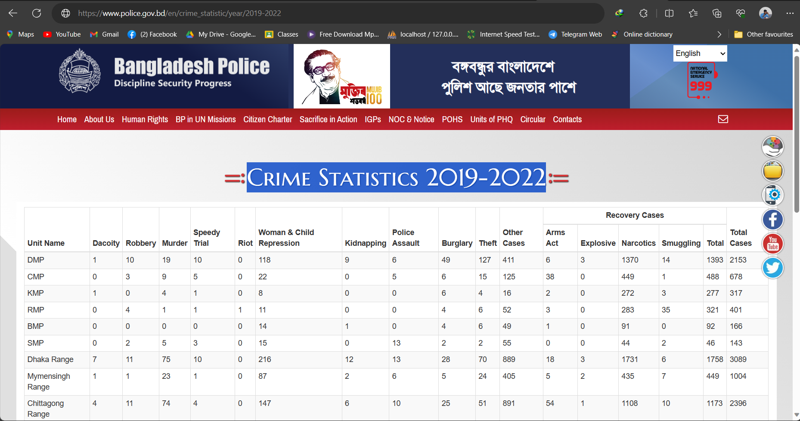
Data Collection
We are collecting crime data to another Sources of data like (police records, government reports, Kaggle, etc.)

Slide 7
Dataset Description
Crime analysis datasets typically contain information related to various criminal incidents and activities. These datasets are essential for law enforcement agencies, researchers, and analysts to gain insights into crime patterns, trends, and hotspots.
Incident Details
Geographic Information
Offender and Victim Characteristics
Arrest and Clearance Data
Time and Date Information
Crime Locations and Types
Incident Status

Slide 8
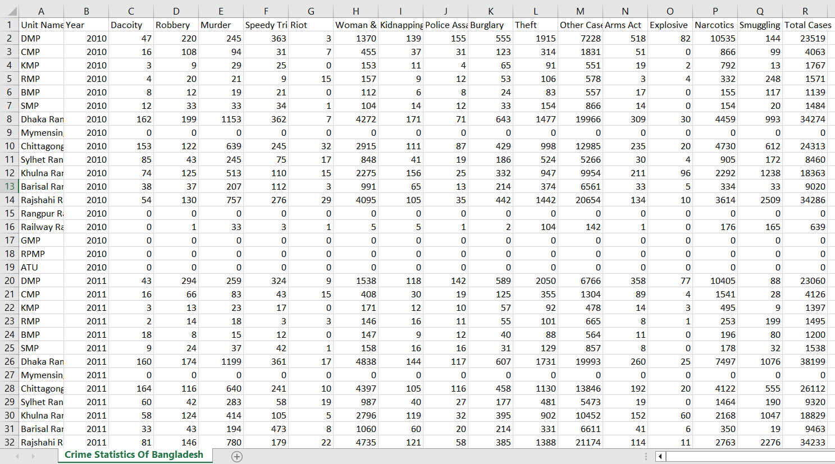
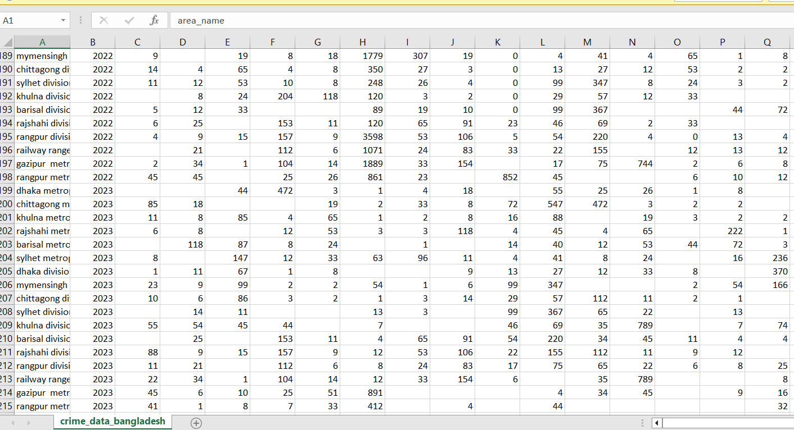
Dataset Description
Dataset 1
Dataset 2

Slide 9
Tools and Technology
Technology are:
Tools
Google Crome
Brave
Google Colab
Pandas
Seaborn
Data Mining Models

Slide 10
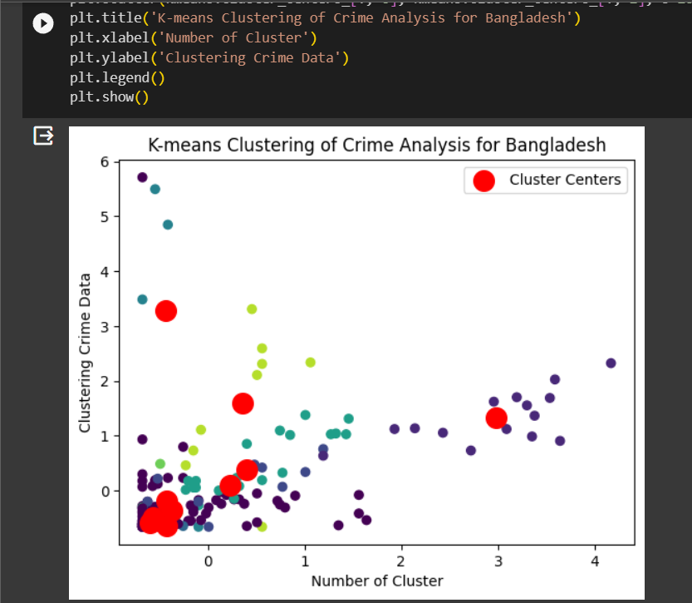
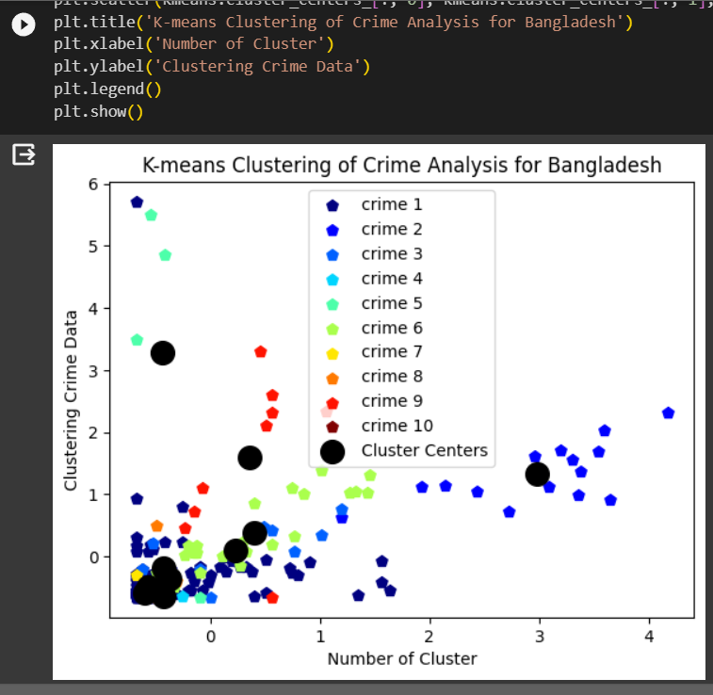
Data Clustering
K-means clustering data of crime analysis for Bangladesh (label and without label)

Slide 11
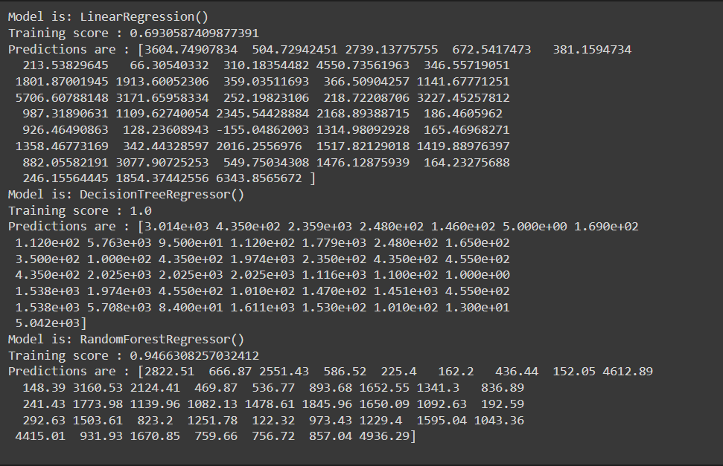
Machine Learning Algorithms
We are using 3 machine learning algorithm for this project and show the result.
Linear Regression
Decision Tree
Random Forest
Showing 3 Algorithm predicting value and accuracy

Slide 12
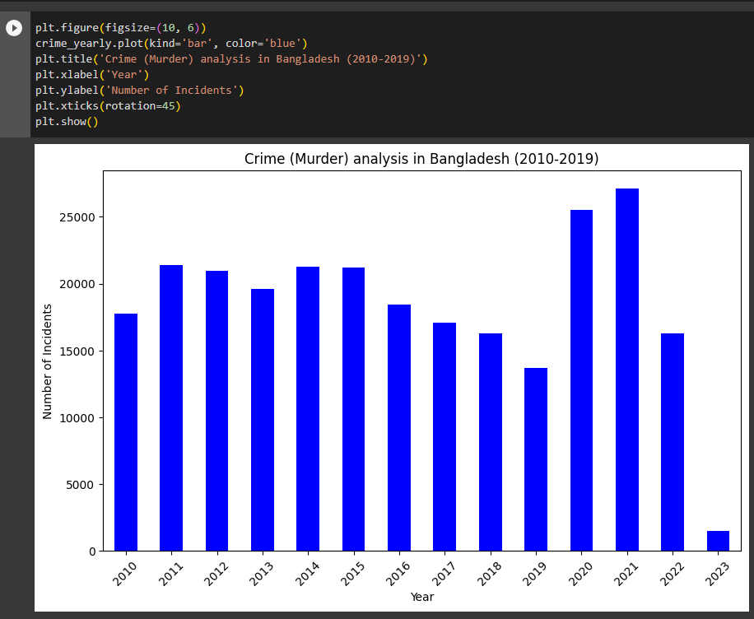
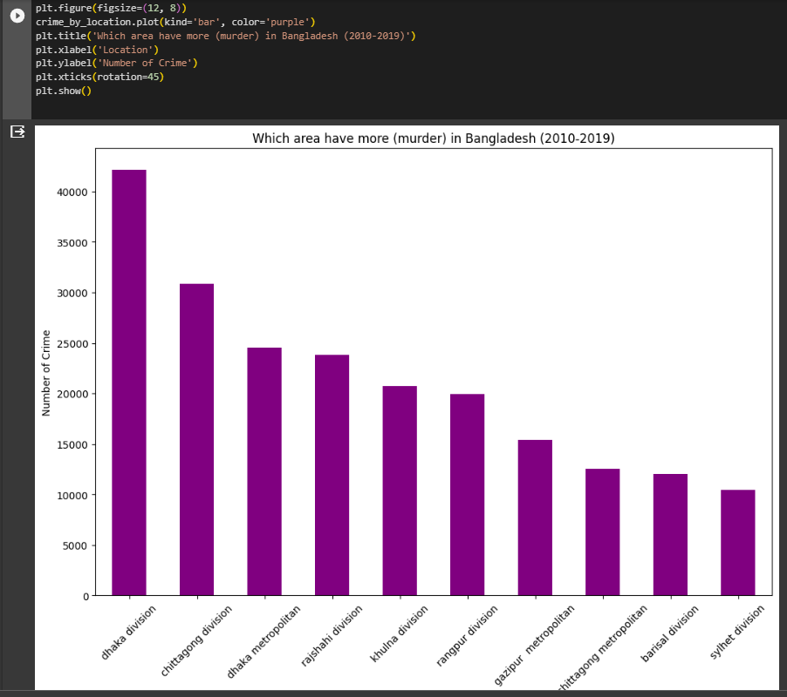
Results and Analysis
Here in the 2 graph first of the graphs year wise and secondly are given according to area of crime

Slide 13
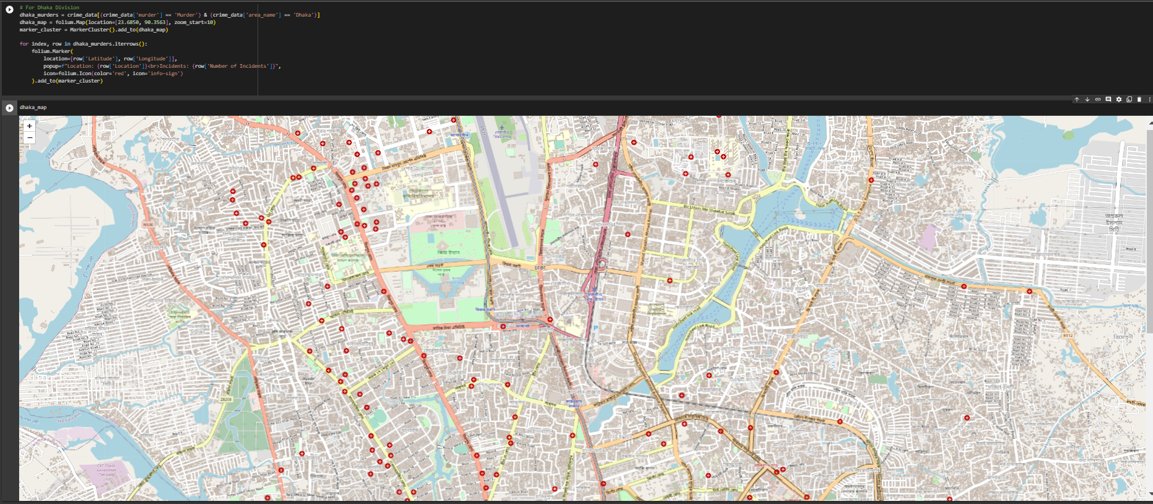
Most of the places of murder in Dhaka area are identified here by maps

Slide 14
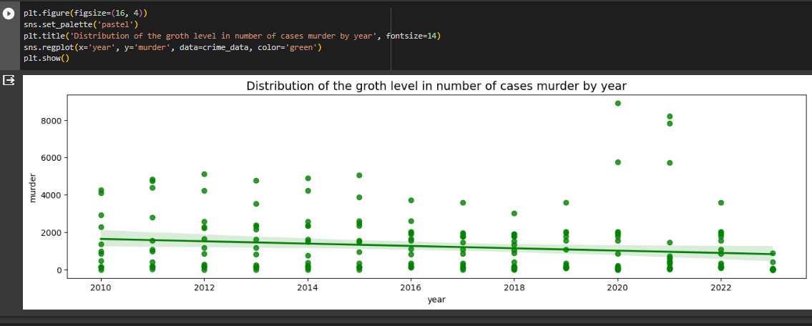
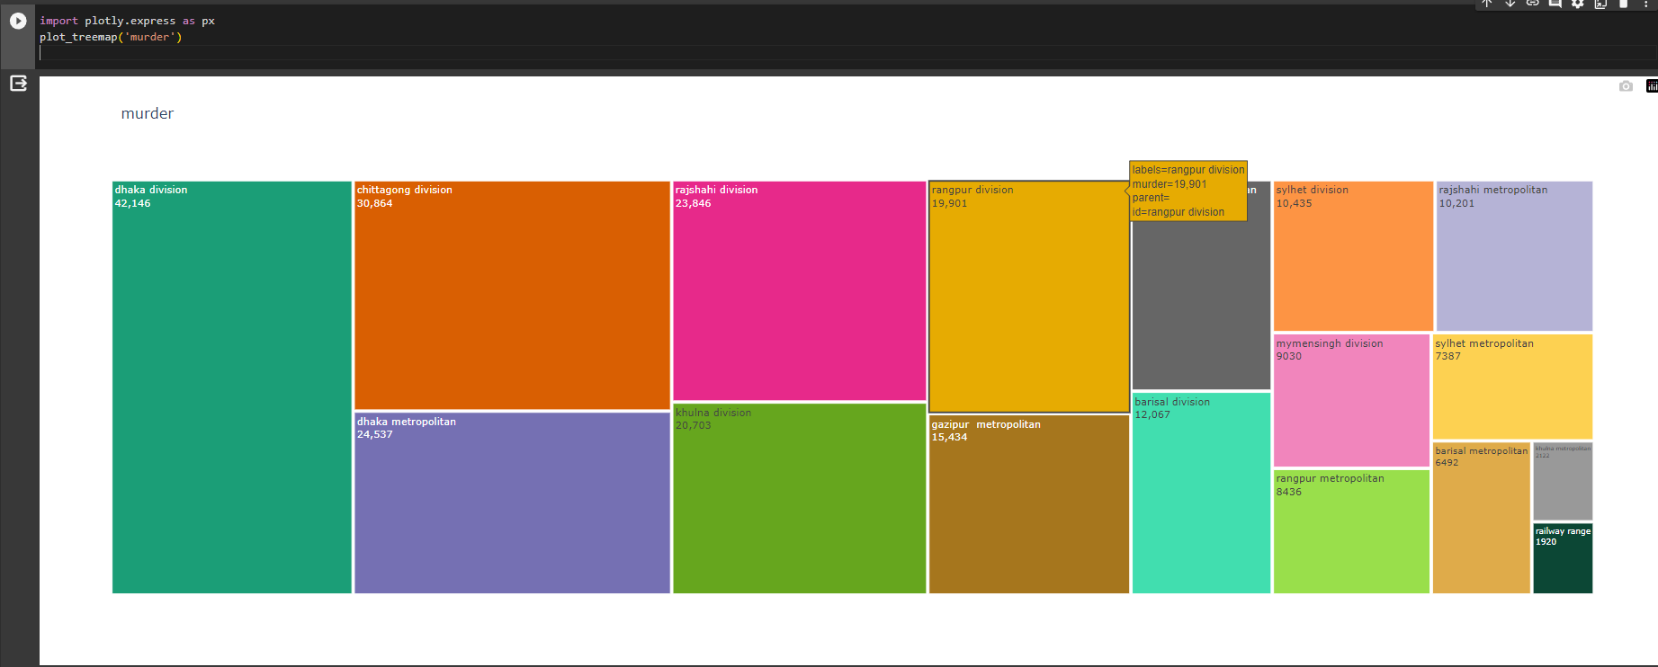
From 2010 and mid 2023, was shown the grow-up label of murder
From year 2010 to year 2023 is sum of murder for all areas.

Slide 15
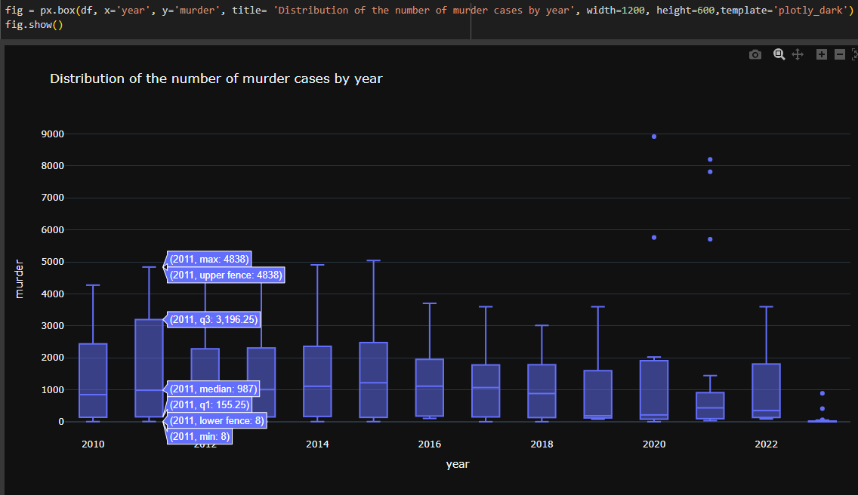
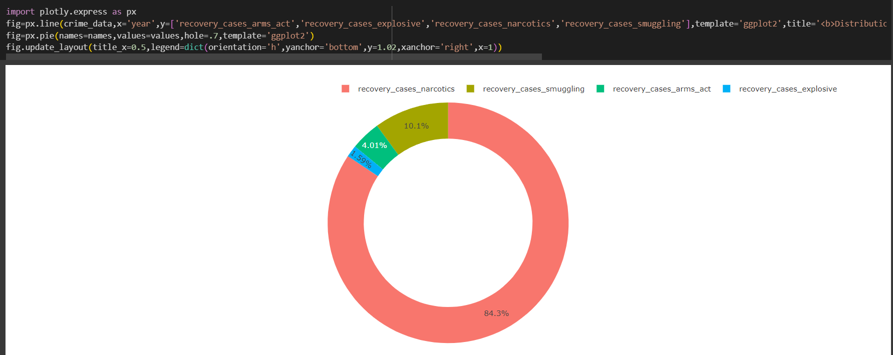
Here is the value of a box plot for murder, here present at (maximum value, minimum value, median, etc)
Values ​​of all recovery cases are shown through pie charts

Slide 16
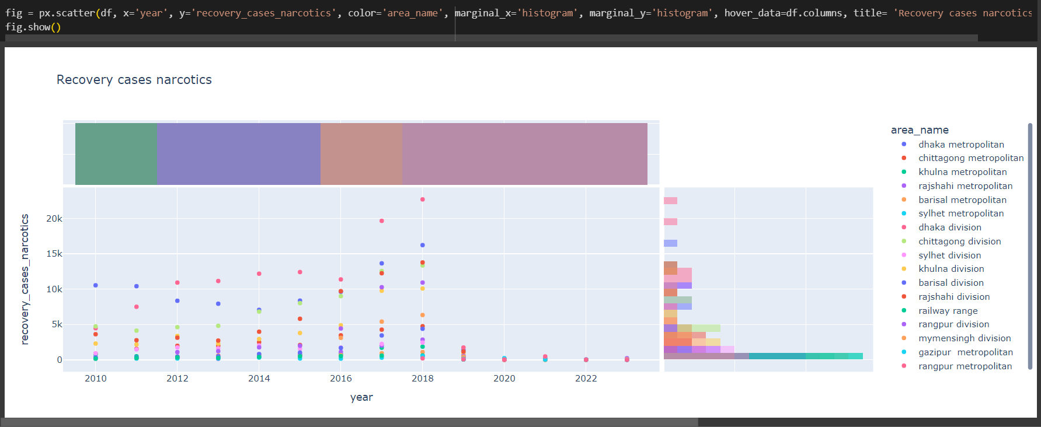
The year and area of ​​the recovery case is also shown, from which it is understood how the recovery took place.

Slide 17
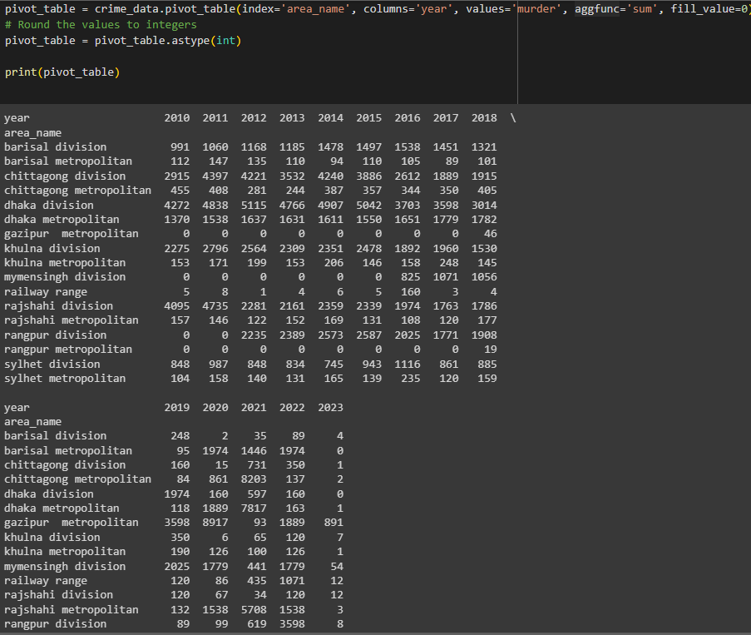
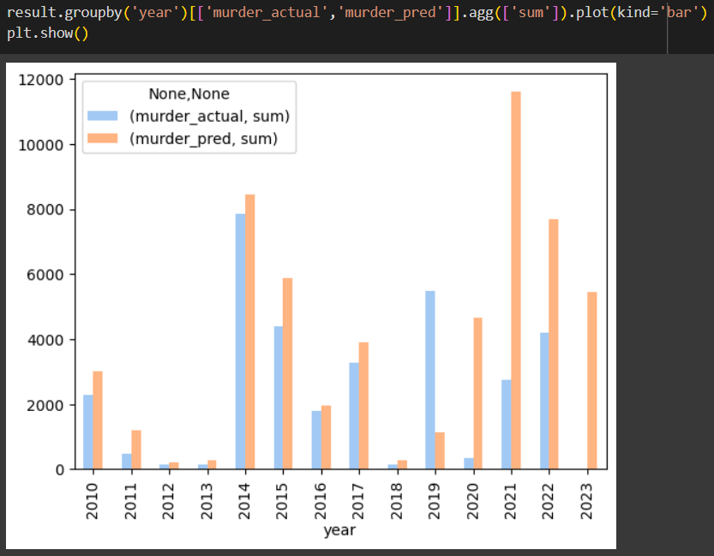
Here the values ​​are plotted according to the murder area and this year
Here is a prediction value generate of what the crime rate would be in any given year, along with the actual values.

Slide 18
Conclusion
The project's success lies in its ability to improve crime prediction, optimize investigative efforts, and foster community engagement. By embracing evidence-based decision-making, we have laid the foundation for a safer society. Going forward, we must continue leveraging data to strengthen law enforcement's capabilities, ensuring a safer and more secure environment for all citizens.
In conclusion, our machine learning-based crime analysis in Bangladesh offers valuable insights, from predictive capabilities to enhancing public safety. While challenges exist, our commitment to ethical and equitable solutions will pave the way for a safer and more secure society. Thank you for your attention, and together, we can continue to make a difference.

Slide 19

Thank You

